Slide 1
Recognizing and Nurturing Technical Intuition
CS4HS 2012
Kean University
Dr. Michael Barnathan
Senior Software Engineer, Google

Slide 2

Who am I?
Senior Software Engineer at Google, joined in 2010.
Ph. D. in Computer and Information Sciences from Temple University.
Adjunct Professor of Computer Science at Monmouth University, 2008-09.
  Data Structures! Algorithms! Java! Life?
  K-nearest neighbor classification? Massively multithreaded servers?
  Students independently coming up with their own projects? Sneaky.
  Pretty radical teaching philosophy, but paid off. 4 year follow-up:
    One student turned his course project into a publication, now a researcher.
    K-nearest neighbor project inspired one student to go into machine learning.
    Lunch with a student at Google on Friday; he’s in the final interview round.
Trying to start a school: http://www.projectpolymath.org
Started coding at 8!
  First thing I did was corrupt my hard drive. Six times.
  Fascinated by the atmosphere before that – didn’t want to go out “if cumulonimbus clouds were outside”.
Published medical researcher.
michael@barnathan.name

Slide 3
Why so much passion?
Became a CS Adjunct, loved it!
Technology education was my life!
Math + Peer Tutor
Notes:
Before I dive into the “macroeconomics” of why STEM education is so important, I want to quickly explain a bit of my passion for this area. As mentioned, I’ve been doing this for a long time – early enough to bring it into conflict with school.
My formal education largely turned my passion for the field that eventually became my career into a liability. That left a pretty deep impression, and once I miraculously made it into college, I realized just how effective technology education could be. That inspired me to start teaching, and the rest is history.
I’ve lived this debate from a number of sides.

Slide 4
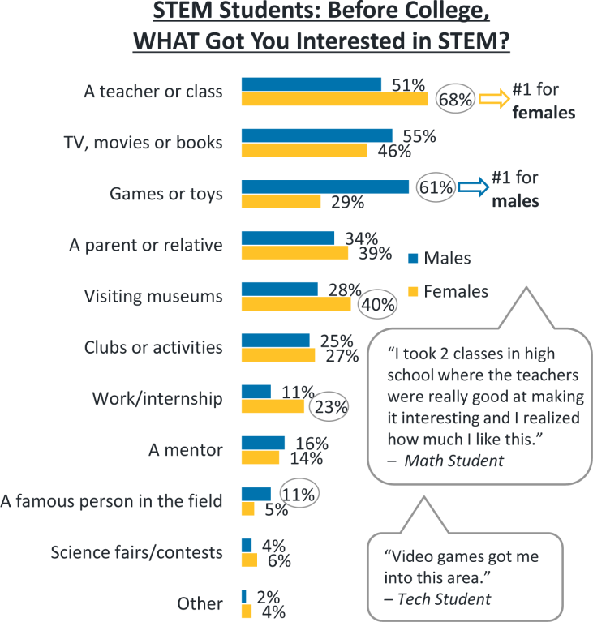
Why is this important?
You are here
Source: http://www.microsoft.com/en-us/news/presskits/citizenship/docs/STEMPerceptionsReport.pdf
Notes:
But there’s another, more important reason why I’m up here talking about this: There’s a major shortage of science, technology, and engineering (that is, STEM) graduates, and, as I just mentioned on the last slide, the system isn’t exactly doing a great job of making their paths easy.
So here are the “macroeconomics” of the situation in the form of a couple of charts from a Microsoft survey conducted on 500 STEM college majors. It turns out that over half of them first became interested in the subject in high school, with the majority of the rest finding their interest in college.
So as high school teachers, *click* you’re one of the primary influences on a critical period of these students lives, when most will either take up STEM or fail to.
And if we look at this second chart on the right, it sounds like the students agree: teachers and classes had the most impact, particularly for female STEM students.
So let’s take a look at some of the quotes. One student says “I took 2 classes in high school where the teachers were really good at making it interesting and I realized how much I like this”. Good teaching has a HUGE impact! Huge!
Another student said “Video games got me into this area”. Video games? Evil video games? As I’ll discuss a little later, that is the gateway drug of choice for many STEM students. Actually, that was how I first entered the field.
And that’s on the chart as well: 61% of male students, games or toys. So to get students interested in science, there are two things you need to do: inspire them directly… *chuckle* and let them play lots of video games.

Slide 5
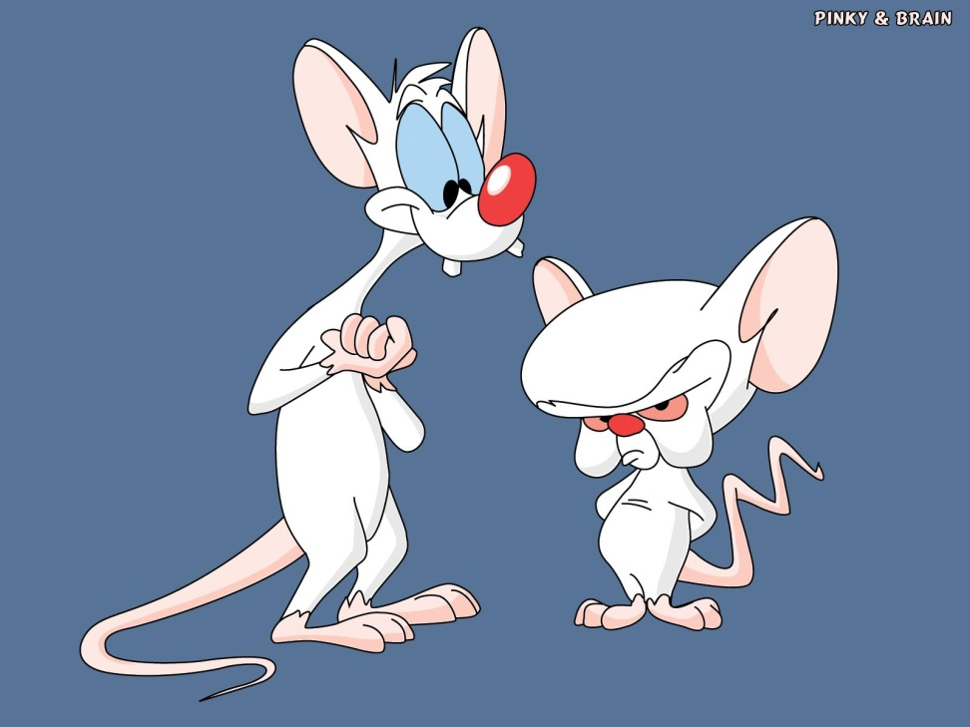
“Technical Intuition”
“I think so, Brain, but where are we going to get string, monopoly money, and a flock of pigeons?”
“Are you pondering what I’m pondering, Pinky?”
Technical intuition: an analogy-driven understanding of a technical problem through its relationship to what is already known.
Notes:
“So let’s talk about that student who said “Wow, teachers made it interesting!”. What I primarily want to talk about today is how to make science interesting and accessible through something which I call “technical intuition”. I’ll also contrast this with the more common notions of “technical thought”, or “thinking like a programmer”.
Before I begin, I should mention that a lot of the methods I’m going to reveal I based on my own experience teaching and tutoring college students and gifted children. The outcomes were exceptional, but that doesn’t necessarily mean that it will carry over. In particular, you have to deal with a lot of regulations which I didn’t. My goals of reforming this system I’ll save for another day.
So let’s kick this off. I’m going to show you two extremely advanced computer science problems. How many of you have computer science backgrounds?
Good! Well, if I can pull this off, you won’t need one to understand what is going on.
To solve these problems, I’m going to need:
String
Monopoly money
And a flock of pigeons *wait* (not shown).
*click*
Let’s begin.

Slide 6
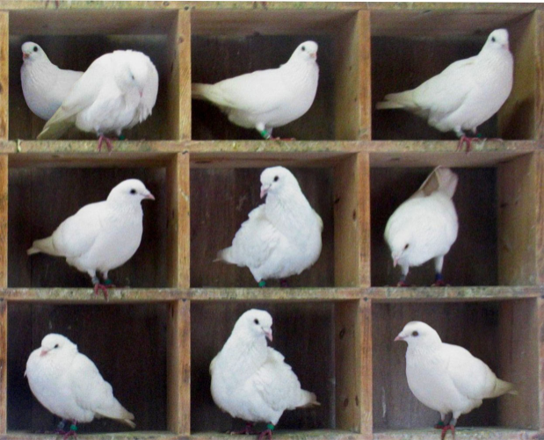
Pigeonhole Sort
?
Problem: Sorting money in ascending order of value.
How would you do it?
Notes:
“I’m about to show you one of the most powerful sorting algorithms taught in an algorithms class, usually toward the very end. And I’m going to do it in 5 minutes. Using monopoly money. Or I should say that you’re going to do it using monopoly money. So let’s say I wanted to sort the bills by their value, in ascending order. Or if I wanted to sort clothing. How would you do it?”
…
And then what?
…
“Congratulations, you’ve just derived an extremely powerful sorting algorithm. Here’s another question: how many times did I need to look at each bill to do the sort?”
“Right - once or twice depending on whether you count looking at the pile. So we would say that this algorithm scales linearly with the number of bills. Or in a computer scientist’s notation, it is O(n). Of course, we did have to look at each of the piles once too, so O(k+n), where k is the number of piles, or distinct bill numberings. But that’s just notation. You understand the essence.”
“The algorithm you just came up with and analyzed is called pigeonhole sort. It’s one of the fastest sorting algorithms available, when it applies to your problem. Some algorithms courses teach it very late, some never even get to it. You just derived it in its entirety in 5 minutes. And for those of you who are programmers, the implementation shouldn’t take much more time than that.”
What I’m trying to illustrate here is the power of intuition, of “thinking like a programmer” - or a mathematician, scientist, or engineer. It isn’t about acquiring vast amounts of arcane knowledge, it’s about the way that you see the world and the problems that you solve. One of the most powerful sorting algorithms in the discipline turns out to be the way that you would sort things anyway.

Slide 7

Intuition and Logic
You cannot describe what happens when you learn something, and you can’t control when it happens – it’s subconscious.
Learning is an intuitive process. Acquiring that intuition is the “click”, the “light switching on”.
Repetition is not intuition. Intuition is understanding one problem, not solving 50 by blindly applying rules.
Excessive formalism often interferes with acquiring intuition, but intuition assists in understanding formalism.
Notes:
But let’s differentiate this from explicit logic. One of Google’s primary educational values is “encouraging computational thought”. I know what they’re talking about – there’s a “mindset” that most programmers have.
Have you ever crossed a field and wondered “If I cut across the lawn instead of walking around it on the sidewalk, how much faster could I make my route?” No? Maybe I’m just weird, but I used to think about that all the time. That’s the mindset: the notion that you can come up with creative logical solutions to build and optimize things, even trivial things like that. “Everything can be improved” is the mindset. You can then think about the everyday world in a very technical, rule-driven way.
Since I walked to work and to class, my mind wandered to this often enough. And as I learned more, I noticed a curious phenomenon: I’d be thinking the same thing, but in terms that were progressively more and more arcane:
For example, I’d start by saying:
“Oh, I should cut across because the shortest distance between two points is a straight line”
Then “Oh, because $\sqrt{a^{2}+b^{2}}<(a+b)$”
Then “Oh, because the Euclidean distance is less than the Manhattan distance” (especially in Times Square)
Then “Oh, because the $L_{2}$ norm of a Euclidean space minimizes the mean squared error”
By the time you’re finished, you’ve taken a simple concept and made it 10 times more complex than it needs to be. What I’m going to demonstrate now is how to cut through the complexity, not so much by following the process of “technical thought” to its end, but by the mental shortcuts and analogies that I think most programmers and scientists take without realizing when they think about these things:

Slide 8
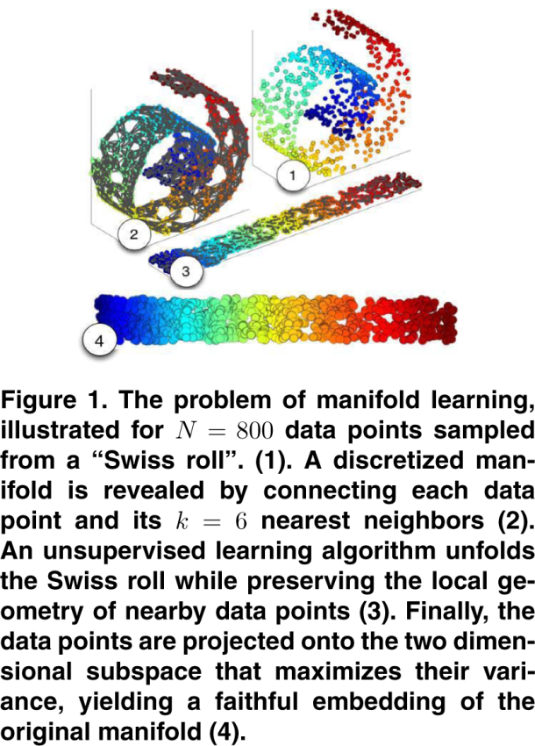
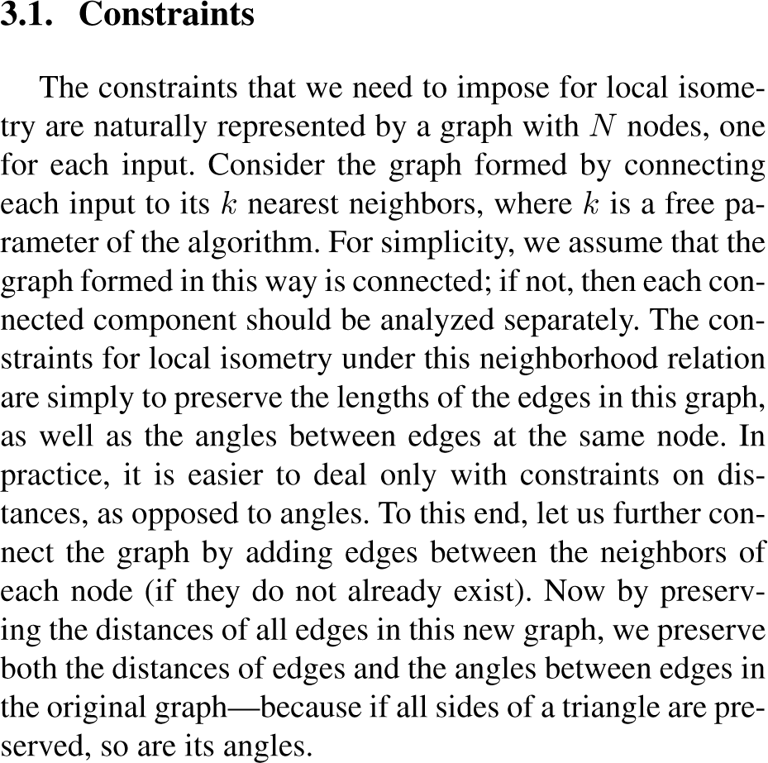
Intuition and Logic
Swiss roll
Fruit rollup.
Weinberger, K.Q., Saul, L.K. Unsupervised learning of image manifolds by semidefinite programming. CVPR 2004, Vol. 2, pp. 988-995.
http://repository.upenn.edu/cgi/viewcontent.cgi?article=1000&context=cis_papers
You cannot describe what happens when you learn something, and you can’t control when it happens – it’s subconscious.
Learning is an intuitive process. Acquiring that intuition is the “click”, the “light switching on”.
Repetition is not intuition. Intuition is understanding one problem, not solving 50 by blindly applying rules.
Excessive formalism often interferes with acquiring intuition, but intuition assists in understanding formalism.
Notes:
So here’s another example – something much more advanced. This is stuff that you wouldn’t ordinarily see unless you were going for a Ph. D. in machine learning.
I’ve attached a snippet from the paper which presents a data mining technique called “maximum variance unfolding”, one of the most powerful techniques in the field. If I were to present it in the traditional way, I might read the abstract, give a quick summary, and jump right into some complex notation and formulas.
But that’s showing you the formalism before the intuition, and that’s counterintuitive. Unless you’re far smarter than I was when I ran into this paper, it’s completely incomprehensible right now. Discretized manifolds? Local isometry? No idea what’s going on. But go study it for hours and at the end, *maybe* it will make sense.
So I did that for an assignment, but encountering this paper was an “ah ha” moment for me. Because when I finally figured out what was going on, I realized just how easily very simple concepts could be couched in insane amounts of complexity.
So I’m going to show you how this works right now. I think you’ll get it.
Here’s a piece of string. Since I’m a total geek, the only string I had handy was a serial ATA cable.
Let me twist it a bit...
Now, we live in 3 dimensional space, and this cable is twisted up so that it’s occupying a space that has length, width, and depth. If you want to describe the points in space that it’s occupying, you’d need 3 coordinates: X, Y, and Z. Right?
So let’s pretend that this cable is infinitely thin. No width. Even then, you’d still need 3 coordinates to describe it, because it’s still moving through 3 dimensions. It still needs an X, a Y, and a Z to be described. The space it passes through still has width and depth.
Now let’s say that I take this cable and do this *yank the ends*.
Remember, we said it has no width, so now it’s just a horizontal line. How many coordinates do you need to describe it now? Just one – it projects onto a single axis.
That’s because this cable, even when it was twisted, actually had an underlying dimensionality of one. It was really just a twisted up line! A one dimensional object in a three dimensional space is an example of a manifold – a collection of points with a lower underlying dimensionality than the space it inhabits.
What I’ve done by stretching this string out is the entire maximum variance unfolding algorithm. I’ve “learned the manifold”, abstracing away the twists and turns, and I can now describe any point on this 3D string (twist it back up) with just one coordinate, because I know how to map it into one dimension.
That’s insanely powerful. Very close to the sort of math that powers Amazon’s product recommendations, actually. It turns out that you can squash users’ product browsing habits down into a manifold too, if you put them in the right representation.
Now, let’s take a quick look at this part of the paper again. Suddenly it makes more sense. What’s going on in this figure is what I just did to the cable. You take a 3D dataset and “unroll” it by pulling it straight, and then you can describe it with just two points. I’m not going to go into the formal definitions and equations right now, but I bet if I presented the notion of a “neighborhood graph” and “local isometry” in the same way, you’d get all of those details pretty easily!
*click*
More importantly, you’ll now remember what this algorithm does if you run into a problem that you can use it on, and you’ll say “Ah ha! That’s the stretchy fruit rollup algorithm. I can use maximum variance unfolding to solve this. Let me go find the code on the Internet”.
Looking up solutions on the Internet? On a test that would be cheating, but in the real world, it’s essential. You don’t want to get mired down in implementing maximum variance unfolding. You want to use it and get on with solving your problem.
Let’s talk a bit more about that.

Slide 9

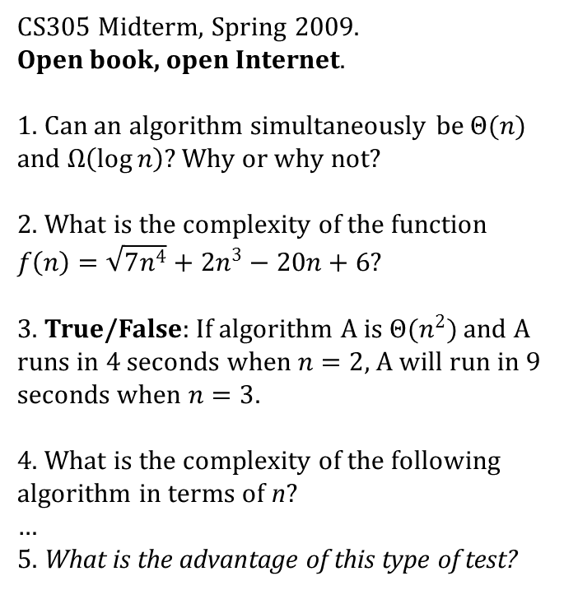
Thinking > Memorization
Real-world problem solving:
CS305 Midterm, Spring 2009.
Open book, open Internet.
1. Can an algorithm simultaneously be $Θ(n)$ and $Ω\left(\log{n}\right)$? Why or why not?
2. What is the complexity of the function $f\left(n\right)=\sqrt{7n^{4}}+2n^{3}−20n+6$?
3. True/False: If algorithm A is $Θ(n^{2})$ and A runs in 4 seconds when $n=2$, A will run in 9 seconds when $n=3$.
4. What is the complexity of the following algorithm in terms of n?
…
5. What is the advantage of this type of test?
Intuitively understand the problem
Create a hypothetical solution
Look at Wikipedia a lot
Implement the solution
Test the solution
No
Did it work?
Yes
Peanut butter jelly time!
Average grade: 84%
Notes:
All this talk of intuition isn’t to say that stepwise thinking is unnecessary. It’s critical! Here’s the general approach to solving a real-world problem used in both academic research and industry. I call this the generalized Feynman algorithm, after Richard Feynman’s “write down the problem, think really hard, write down the solution” approach.
1. First you need to intuitively understand the problem. That’s what I just showed you.
2. Then you get creative and generate a hypothetical solution – an approach which you think will solve the problem.
3. Then you implement the idea, which is where domain knowledge and skill really come into play.
4. It’s not usually enough to implement the solution – then you have to test it to make sure it actually solves the problem! That takes strong critical thinking skills and requires being more than a little thick-skinned. In some cases, like at Google and in academia, it involves a peer reviewer poking holes in your solution.
If it doesn’t work, you modify the idea or create a new one and keep iterating until you find something that works. There’s sometimes a lot of failure in this process, and that’s ok. I did 6 months of work on my dissertation research before realizing that I had a dead end solution. But I started over and found one that worked. Part of the process.
So if I can pull everyone’s attention away from the dancing banana for a moment, on the right side is what I would consider a successful trial of a “thinking-oriented” midterm.
Most tests, even at the college level, still check for basic memorization, and I went out of my way to avoid that. So this one is open book, open Internet – the only thing I didn’t allow was chatting with other students, and in the real world even that would be encouraged.
But the average was 84, not 100. The Internet is a great reference, but these questions required thinking. The test is whether the student understands them well enough at the conceptual level to apply them correctly to novel situations. It’s a very different type of test.
*click* So what’s the advantage? Well, in the real world, there’s a hidden step in this problem solving algorithm: *click*.
This is 2012. We have Encyclopedia Galactica, 1000 years ahead of schedule. It’s just a second away, any time that I need it. Is memorization so important? Knowing how to locate the information and apply it properly is more important.

Slide 10
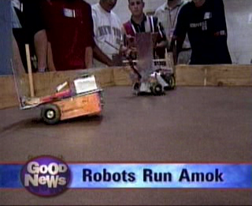
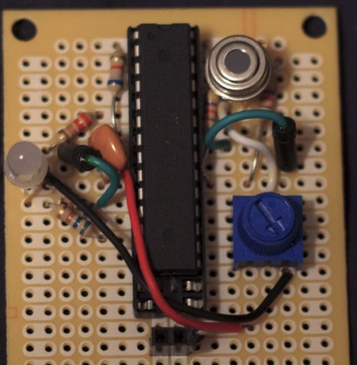
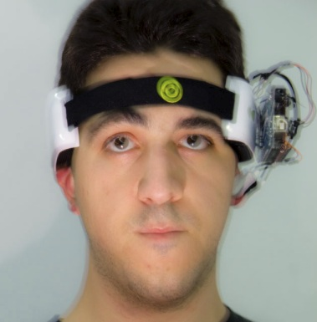
Creativity in the Classroom
public class SingingFrog extends Frog {
public SingingFrog(Song frogSong) { … }
@Override
public void croak() { … }
}
>
“This is a constructor…”
“This is a destructor…”
“This is a method…”
Hands-on creative learning is critical.
Autodidactic programming is almost always hands-on.
Make lifechanging experiences for your students:
  Playing with Capsela toys in 4th grade sparked interest in electronics and robotics.
  Now creating brain-computer interfaces and trying to treat Parkinson’s disease.
Notes:
Technical learning is hands-on. Project-based. Experiential. Call it what you like, you won’t read most of what’s important in a book. You’ll learn it by creating something with it. And not in some sterile environment where you can’t see a problem’s context, like in the exercises in a math book. It needs to be applied, constantly in new situations that require thinking about the discipline differently.
It’s pretty vital to incorporate some of that into the class. Waldorf education actually does this, as do some of the gifted enrichment programs. They sit you down in an immersive environment and let you create things. It blurs the line between learning and play.
For example, I get paid to program, but I’m also pretty experienced in electronics. That was sparked entirely when my 4th grade teacher sat us down with Capsela toys and let us go wild. A decade goes by, and these days I’m creating brain-computer interfaces for monitoring and treating Parkinson’s disease. Here that is, if anyone is curious. I’ll be happy to show how it works later if anyone is interested. But a positive classroom experience really just led right up to this type of stuff. Once something sticks, it never unsticks, and before you know it, you’re building mind control helmets and plotting world domination.
There’s a nice push toward this in college programming now. There’s some klick and play program called “Alice” which I see a lot of colleges using nowadays. Honestly, I hate that particular program, but the general idea is sound – start by doing, let students create stuff as part of their learning.

Slide 11
How do you get 8-year olds to program, anyway?
Don’t assume they can’t do it. Kids can learn very fast and tend to be very creative.
Bring the concepts down to their level, present them intuitively, and connect them with the known.
Make it a game (and let them make games).
Show them role models who do it. Be one if possible.
As teachers, point students who are exhibiting proficiency at additional resources.
  “College for kids” programs, interest groups, hackerspaces, competitions.
  Companies at the forefront of the field.
  In high school, actual college courses and faculty research.
Notes:
With all this talk of 4th grade experiences leading to lifelong passions, it’s a good time to mention that an intuitive presentation defies background and age. You don’t need a background to understand pigeonhole sort, unless you make the mistake of trying to learn it from an algorithms textbook. So I’m going to talk a bit about how to get students involved at very young ages. Why? Because prior experience sets students up for success later in life.
I polled my class at the end of the semester (after grades were finalized) for how many years of programming experience they had before taking the class. Here’s an aggregated and anonymized scatterplot of experience against grade. Lots of students also say “teach it as early as possible” in the Microsoft survey, which is exceptional advice.
So how to expose 8 year-olds to programming? And by programming, I mean “learn calculus” or “build robots”, or any number of things.
First, stop assuming they can’t do it. That’s the #1 mental block that prevents people from learning new things. You can, for example, learn how to take a basic derivative without knowing more than a tiny bit of algebra, but no one would ever think of trying to teach any calculus at all until two years of algebra and one year of precalc. Kids learn quickly and are very creative. Don’t underestimate them. When they show a willingness to learn outside of their boundaries, let them explore!
The secret is what I just did with that manifold learning work: make the topics accessible and intuitive, and stay light on the formalism until they understand what it means. Connect it with what they already know, even if it’s what you just taught them – this “springboarding” was a technique that worked very well in my classes; it completely carried over when I tutored younger students as well. Can you teach everyone everything? No. But what people assume are limits of age simply haven’t been challenged enough.
Second: Play is not bad. Play is how kids learn about the world. 61% of male STEM students were first interested by toys or games, and I was among them. One of my games actually ended up defining my childhood and was probably the only thing that got me accepted to a four year college. So if students want to make games, let them make games! Programming is programming.
Interest groups and role models. I know your hands are a little tied here, but I’d even try to organize periodic “show and tell” or “reading group” events where people can show off what they’ve built and collaborate with other students. It’s one thing to tell students what they need to learn, and another to say “Look what I just made! Want to learn how to make one of these too?” Role models are powerful. They’d roll their eyes at first, but I guarantee you’d have half the class interested in about two weeks. They really keep you motivated to learn the subject and create interesting projects.
Want students to turn their passions into careers? When you see a student exhibiting evidence of proficiency, it’s your responsibility to recognize it and to point that student at the resources available to him or her - in the school, in academia, or in industry. Most companies would love to help students who are interested in technology. I know that Google is. They’re the company’s future employees!

Slide 12
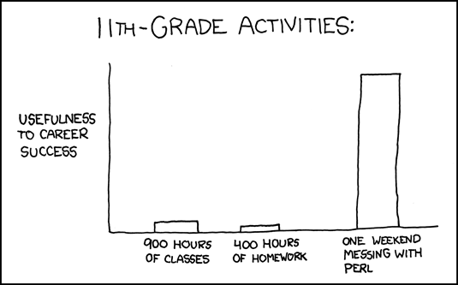
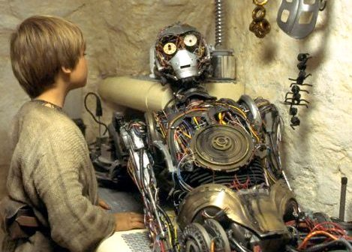
Recognizing a technical mindset
Common traits of technical padawans:
  Insatiable curiosity, asks “why?” a lot.
  Desire to make, to build, to improve, to customize (“takes things/ideas apart”). “Makers”
  Perfectionism, tries to “optimize” everything.
  Deep focus, sometimes to the exclusion of more mundane schoolwork (possibly “underperformers”).
  “Geeky”, makes references to geek jargon (e.g. “grok”) and culture. Reads xkcd.
More general signs of developmental potential:
  Overexcitabilities (Dabrowski):
  Early learning in areas outside of the curriculum (with or without engagement inside of it).
  Leadership/sense of purpose at an early age.
Randall Munroe, xkcd: xkcd.com/519
OE | Manifestation
Psychomotor | “Can’t sit still”, high energy, may be misdiagnosed as ADHD.
Sensory | Deep connection to music, art, food, the outdoors, etc.
Intellectual | Highly curious, builds a large knowledge base at an early age.
Imaginational | “In the clouds”, thinks about possibilities more than actualities.
Emotional | Deep sense of justice, compassion, right/wrong.
Anakin Skywalker, technical padawan.
--Star Wars, Episode 1
Notes:
But before systematic nurturing of the talent comes recognition of growing technical aptitude - diagnosis before treatment. So now I’m going to share a few of the traits which technically adept students tend to show.
First, and perhaps foremost, is intellectual curiosity. Scientists and engineers are constantly challenging things that most people take for granted, constantly asking “why?” and “how?”. Kurt Godel, the mathematician who discovered the theorem of incompleteness, was known as “Mr. Why”. Questioning assumptions is a necessary skill to making scientific discoveries.
Next, we have the desire to build and improve. This is a key attitude for programmers to have in particular, since a lot of the work in that field is taking a high level description of a problem and creatively building, testing, and improving a program to solve it. If you don’t like doing that, it’s going to be hard to stay motivated in that field. But it’s something that a lot of kids do from an early age – anyone ever build castles out of legos? That’s what I’m talking about. Google actually has an entire wall full of legos open to the engineers. And engineers that we are, it sees a lot of use.
In addition to industry and academia, If you see someone who loves to build things, you should probably introduce them to the Maker movement, and to the concept of “Hackerspaces” – these are do it yourself electronics, computer, and biology labs which get together informally and hack out some things. There are a ton of them in Brooklyn, and a few not far from here, near New Brunswick. There’s a pretty big one called FUBAR Labs not far from here. You can engage a passion for building things very easily, with the parent’s help.
Perhaps more than any other specialization, computer scientists are perfectionists. The hallmark phrase of algorithm design and analysis is “can we do better?” Now, perfectionism is a double-edged sword. It can cause missed deadlines, unfinished projects, and the imposter syndrome, which is the curious trait of high achievers often discounting their own accomplishments. But if it can be brought under control and harnessed, it can motivate people to stay in STEM when things get difficult – which as I’ll mention in a later slide, is one of the key factors to raising STEM retention rates.
There is usually a deep focus on technology, sometimes to the exclusion of other coursework. This can result in a pattern of “gifted underachieving”. I would argue that this is a pattern that needs to be recognized rather than corrected, since the students are prioritizing something they’ll likely turn into a career over material that they probably won’t use much.
And of course, technically adept students are sometimes simply geeky. Actually, we take this to an art at Google – dialogue with coworkers often sounds like “the program is ooming, try grepping the output and running it through jprof”.
There are some more general signs too. I won’t go into Positive Disintegration too heavily, but sometimes students who are unusually “intense” or even “difficult” in certain ways are really showing manifestations of giftedness, so be on the lookout for that.

Slide 13
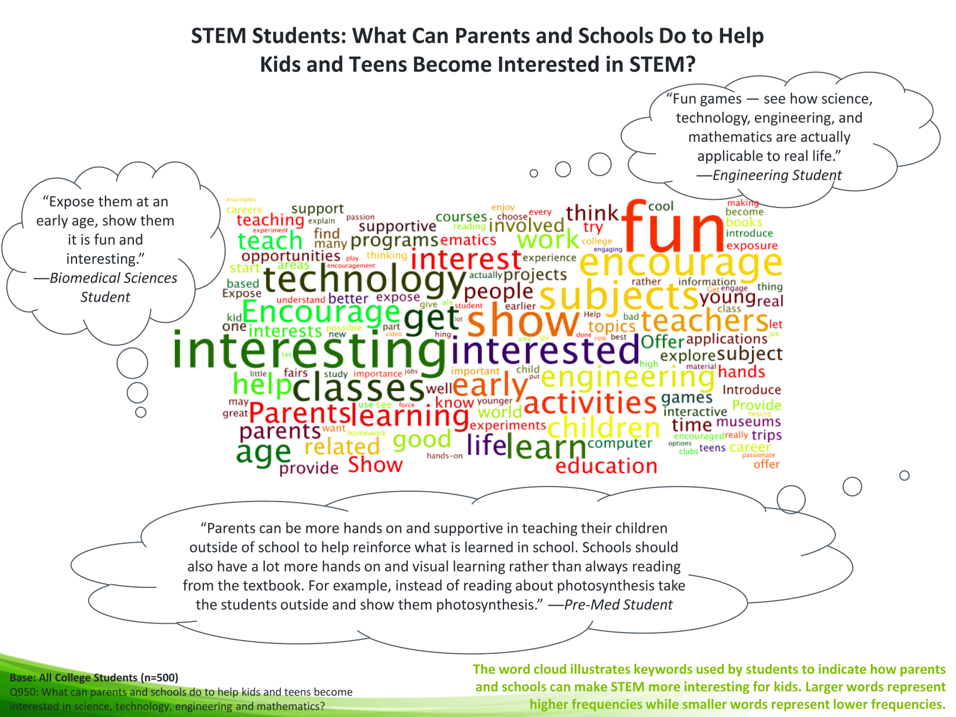
Obvious: Make Learning Fun
Notes:
Here’s some supporting information from the Microsoft survey, collected from 500 students. The most commonly used words to describe what parents and schools can do to promote STEM are “fun” and “interesting”, which sends a pretty clear message. “Show” is a big one too. “Encourage”, “Early”, “Activities”, and so forth. That students learn better when the lesson is fun, I would hope is obvious.

Slide 14
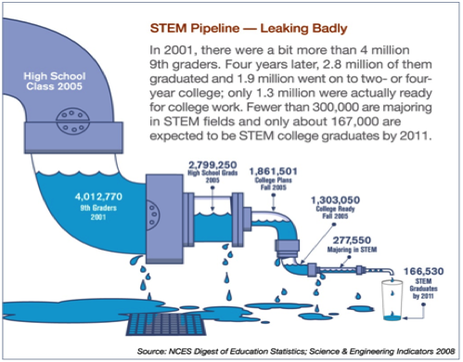
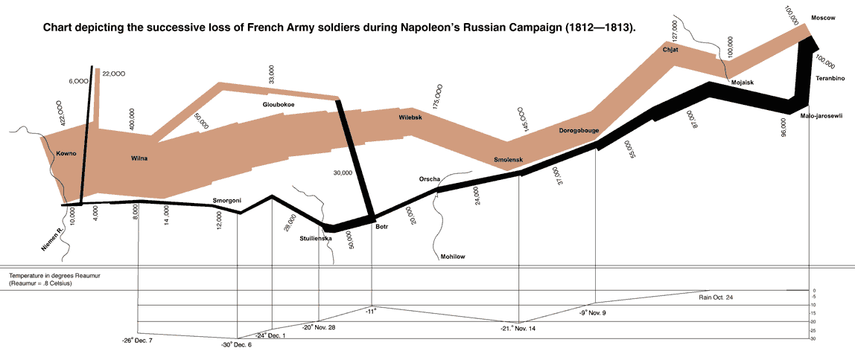
The Problem of Retention
Notes:
We’ve talked quite a lot about how to educate a STEM student. Let’s switch gears now and talk about retention.
Say you’ve fostered an exceptionally talented STEM student. One huge problem is that this student has only about a 5% chance of making it through college in a STEM major.
Changing majors isn’t a problem if the new major is a student’s passion, but that’s a small part of the overall loss in the STEM pipeline. It’s really alarming - the closest analogue I can think of is the famous chart depicting the losses during Napoleon’s ill-fated march into Russia. The actual scientists and engineers are the small black line, the ones who make it back.
Some of the factors are outside of the classroom, but I’ll talk about the ones that are and what can be done.

Slide 15
Why the attrition?
STEM is hard.
STEM students need to be very motivated to survive.
There are few support structures in place among peers, mentors, or faculty.
Certain short-term motivators are “dangerous”: they don’t sustain a strong passion:
  Parental forcing: this generally doesn’t work in any field.
  Big difference between forcing and inspiring: is the desire on the part of the parent or the student?
  Top-down educational incentives: scholarships and grants aren’t cited among strong motivators for students.
  Peer pressure: high school and college peer groups are different, have different values. If one group values STEM and a new group does not, the desire may collapse.
Notes:
Why the attrition? What are some of the reasons why students quit STEM?
Well, I think it goes without saying that STEM is hard. Only the most dedicated and motivated students will tend to survive. True story: I had an algorithms professor who failed 2/3 of my class year. The CS class, which was already pretty small, went from 35 students to 11. Only four of us actually graduated with CS degrees.
Maybe this has changed, but I have not seen many support structures in place for STEM students. While tech. savvy students are accepted more by their peers now than they were when I was in school (probably because these days everyone has an iPhone), there’s still some stigma attached to being “a science geek”. Parents, counselors, and even sometimes teachers don’t always understand an independent interest in technology, so it’s vital to find an appropriate social group and support structure for science students. I think that would really help retention rates.
Other things that tend not to work are parental forcing and top down educational incentives, like scholarships – I have the data on the next page for that.
As I mentioned, I think giving the students strong academic or industry mentors, or directing them at hackerspaces, can help. It’s so important that they have a community which will value what they do, especially at that age.

Slide 16
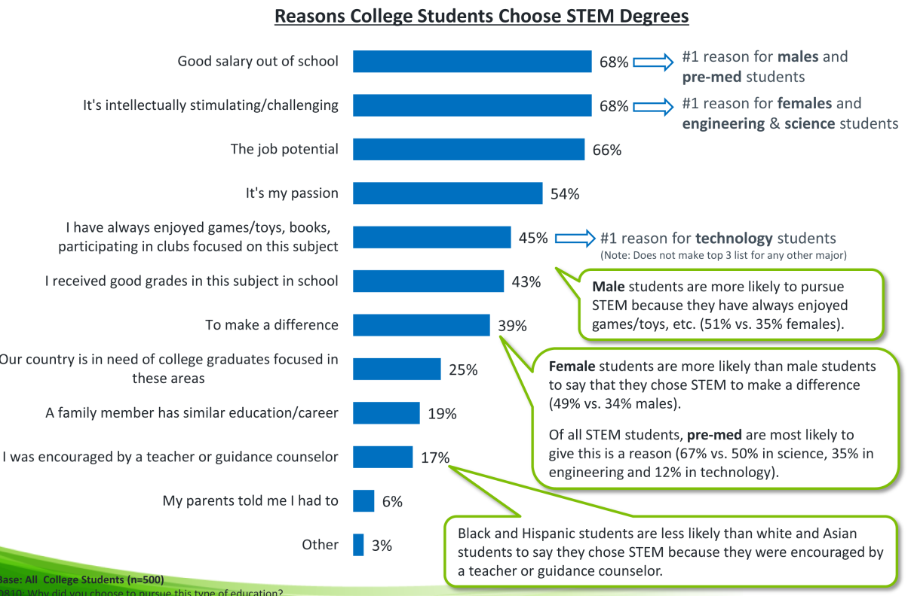
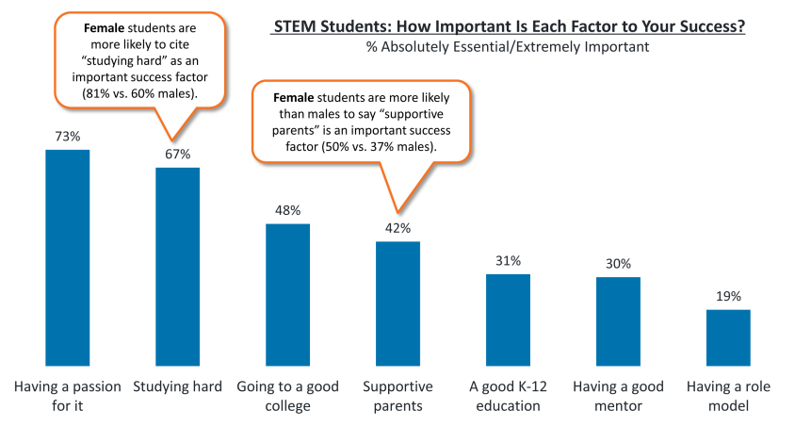
Effective Motivators
Surprisingly, the promise of a high salary is an effective motivator.
(That doesn’t mean that they survive the college major)
Passion and hard work were ranked the strongest factors to success.
Notes:
Other motivators, on the other hand, do seem to spur a lasting interest. I was surprised to see earning potential foremost among these. Among factors ranked crucial to success, however, passion and studying hard were ranked first. Aside from “going to a good college”, all of the remaining top factors had support components. So while money may get people in the door, the passion seems to be what carries them through.
As I mentioned, parental forcing is pretty ineffective. Just 6% say “my parents told me I had to”. I’d imagine that the chance of those students dropping it at the first opportunity is pretty high, unless they really want to do it on their own anyway.

Slide 17
Summary
Intuition is a powerful tool for understanding complex scientific and technological phenomena.
  Presented properly, it can transcend age and background.
  Analogy with the known is a useful technique for accessing this intuition.
Hands-on creative work is vital to effective STEM education.
It is necessary to find strong support networks for students in order to raise STEM retention rates.
Notes:
So that more or less follows a student’s potential path from early interest all the way up to graduation. Hopefully I’ve given a motivation for an intuitive approach based on reasoning and creativity to technical education, as well as giving students opportunities to begin early and a strong support network to ensure that they remain satisfied throughout the many difficulties of a STEM education.

Slide 18
Questions?

